Slide 1
An Investigation into the Impact of a Stress Treatment on the Abundance of the Euryarchaeota Microbe in Cattle
Shane O’Sullivan
Supervisor : Professor Paul Walsh

Slide 2
Table of Contents
Climate Change
Methodology
Literature Review
ANCOVA Modelling
Exploratory Data Analysis
Objectives
Literature Review
Conclusions

Slide 3
Climate Change
Under EU targets Ireland is expected to reduce its carbon emissions by 20% by 2020 from their 2005 levels
According to the IPCC we have 12 years to prevent catastrophic damage (Global Warming of +1.5C)
In 2018, it was announced that Ireland has only reduced its emissions by 1%
Agriculture accounts for one-third of all Irish emissions each year
Source: EPA Sustainability Report 2018

Slide 4

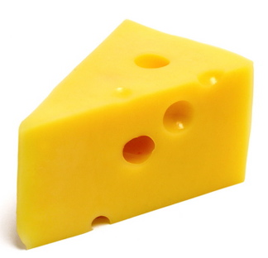
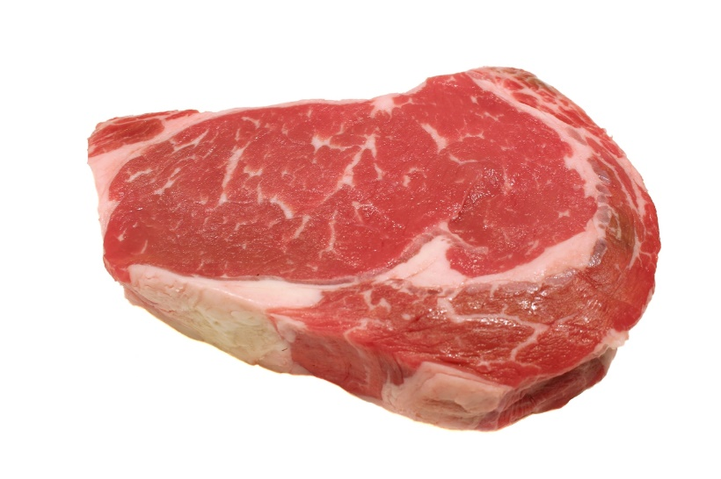
Cattle Emissions
This Photo by Unknown Author is licensed under CC BY-SA-NC
This Photo by Unknown Author is licensed under CC BY-SA-NC
This Photo by Unknown Author is licensed under CC BY-SA
1 Litre = 0.7KG CO2 Equivalent Emissions
1 KG = 1.2KG CO2 Equivalent Emissions
1KG = 8KG CO2 Equivalent Emissions

Slide 5
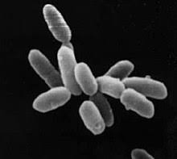
Euryarchaeota
Methane is produced by the Euryarchaeota microbe within the digestive systems of cattle and other ruminants.
1 kg of methane emitted causes as much damage as approximately 30 kg of CO2

Slide 6
Objectives
To determine whether the introduction of a stress treatment on cattle has an effect on the abundance of the Euryarchaeota microbe present.
To investigate if other variables (e.g. Diet, Residual Feed Intake) have an effect on the abundance of Euryarchaeota microbe present.

Slide 7
Literature Review
Diet:
Crushed sunflower, flax and canola seeds when introduced to grazing diets have been shown to reduce methane emissions by cattle.
It has been noted that dairy cattle who graze on an alfalfa-grass pastures produce less methane than those on a grass only pasture.
A University of California study has recorded large decreases to methane production through the introduction of seaweed into a cow’s diet.
Residual Feed Intake:
In a 2007 study cattle who were observed to have a lower residual feed intake had lower methane emissions

Slide 8
Variable Factors
Diet
Concentrated Feed
Residual Feed Intake
Low
Foraging
High
Control
DEX_Group
Treatment
Sampling Round
R1 (Pre-Treatment)
R2
R3 (Post Treatment)

Slide 9
Methodology
As the data was provided was in terms of relative abundancies for each of the microbes detected, analysis of the data was primarily in the form of t-tests and ANCOVA modelling.
Independent samples t-test:
Normality and Equal Variances assumptions were tested. (Shapiro-Wilk, F Test)
During the ANCOVA model building stage, the Euryarchaeota microbe relative abundance was used as the dependent variable

Slide 10
Data Preparation
The dataset contained sampling recordings for in excess of 20 microbes and other substances in the form of relative abundancies.
As many of these features held a relatively low abundance, the exploratory analysis focused on the 6 largest microbes in terms of relative abundance.
Of the 39 initial observations, one was removed as the cow became ill during the study
 | Control | Treatment | Total
PBconc | 7 | 12 | 19
PBforg | 8 | 11 | 19
Total | 15 | 23 | 38

Slide 11
Exploratory Data Analysis

Slide 12
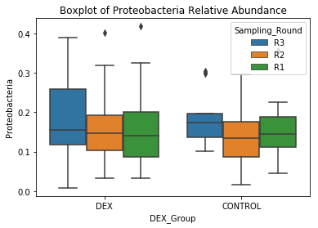
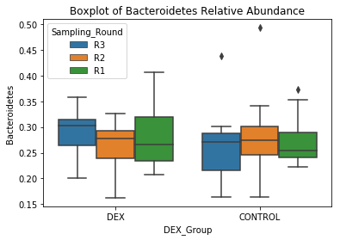
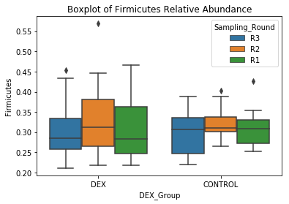
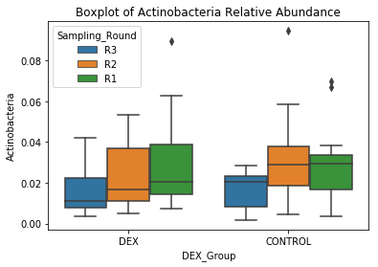

Slide 14
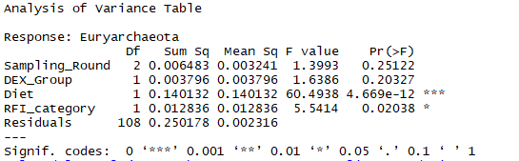
ANCOVA Modelling
Euryarchaeota ~ Sampling_Round + DEX_Group + Diet + RFI_category

Slide 15
Conclusions
Stress Treatment
The analysis conducted did not find any statistically significant impact on the relative abundance of the Euryarchaeota microbe as a result of the stress treatment
Diet
The diet of cattle was found to have a significant impact on the relative abundance of the Euryarchaeota microbe with a primarily concentrated feed diet found to lower the microbe’s abundance.
Residual Feed Intake
Cattle with a low residual feed intake classification were found to have a slight decrease in their Euryarchaeota microbe relative abundance.

Slide 16

This Photo by Unknown Author is licensed under CC BY-SA

